Slide 1
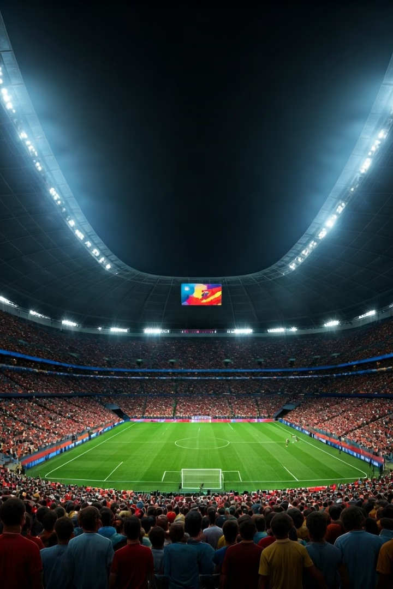
Introduction to the FIFA World Cup Analysis
The FIFA World Cup is a monumental global sporting event. This analysis explores historical data from 1930 to 2014, focusing on key trends and insights.
by Naman Kedia

Slide 2
Overview of the Datasets: WorldCupMatches, WorldCupPlayers, WorldCups
WorldCupMatches
WorldCupPlayers
WorldCups
This dataset covers all matches played, including scores and outcomes.
Contains player stats, including goals, assists, and playing positions.
Details historical information about each tournament, including host nations and champions.

Slide 3

Historical Trends in World Cup Tournaments (1930-2014)
1
Early Years
The first tournament took place in 1930, hosted by Uruguay.
2
Mid-Century Developments
New teams joined, and competition intensified during the 1960s.
3
Modern Era
Increased viewership and global participation defined the 1990 onwards.

Slide 4
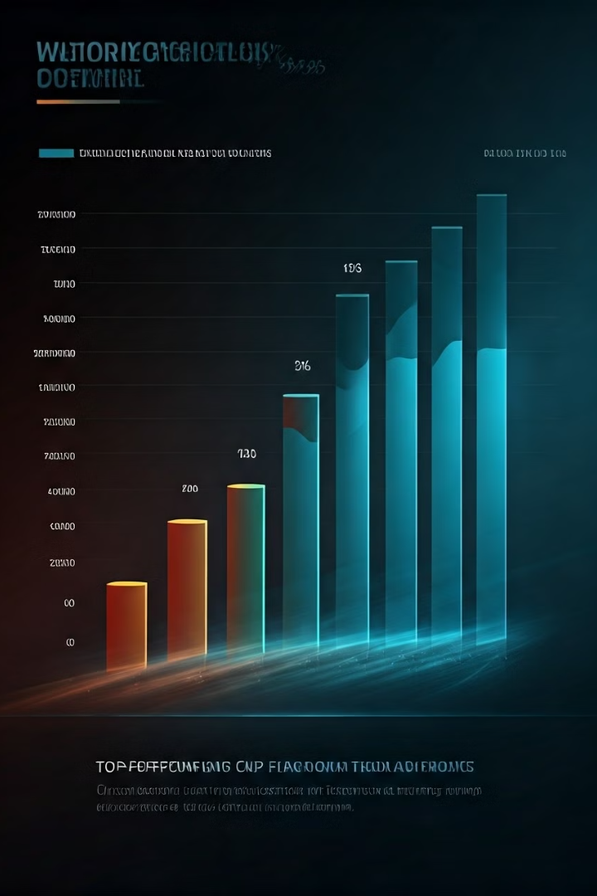
Analysis of Team Performance and Dominance
Team
Titles
Finals
Semifinals
Brazil
5
7
11
Germany
4
8
13
Italy
4
6
8

Slide 5

Player Statistics and Standout Performers
1
Top Scorers
2
Best Playmakers
3
Goalkeepers
Highlighting leading goal-scorers such as Miroslav Klose.
Recognizing players with outstanding assists and gameplay, like Diego Maradona.
Focus on legendary goalkeepers who made the difference, e.g., Lev Yashin.

Slide 6




Emerging Trends and Innovations in the World Cup
VAR Introduction
Data Analytics
Diversity in Teams
Video Assistant Referee technology changed officiating standards.
Teams use data for strategy, analyzing player performances.
Inclusion of players from various backgrounds enriches competitions.

Slide 7
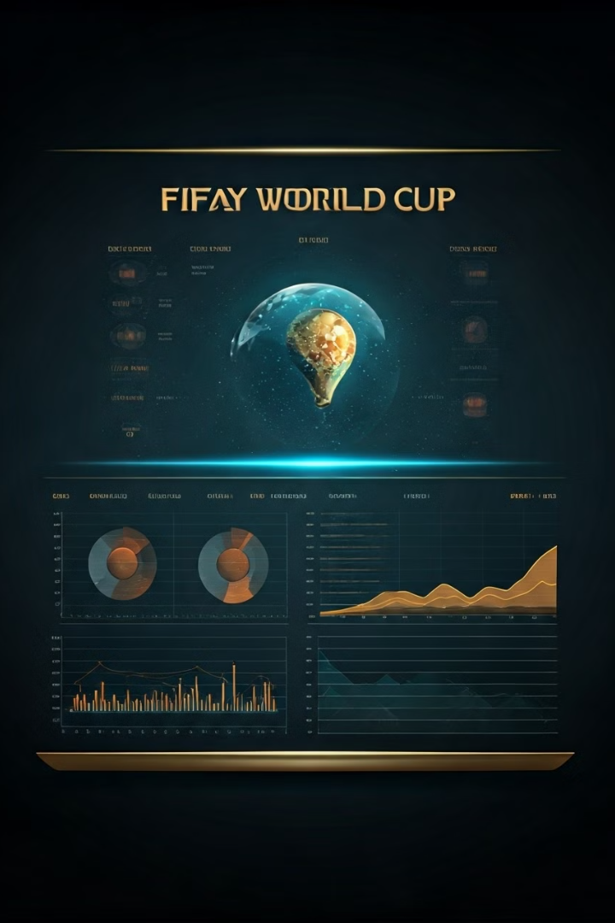
Insights and Findings from the Data
1
Increased Global Participation
More nations compete, reflecting football's growth.
2
Home Advantage
Statistically significant benefit for host nations.
3
Economic Impact
World Cups boost local economies and tourism.

Slide 8

Conclusion and Recommendations for Future World Cups
1
Enhancing Technology
Continue to integrate technology for accuracy and engagement.
2
Promoting Fair Play
Emphasize rules that ensure sportsmanship and integrity.
3
Sustainable Practices
Encourage environmentally friendly practices during World Cups.

